Slide 1

Organizational Behavior
(MGT-502)
Lecture-23

Slide 2
Summary of
Lecture-22

Slide 3
Leadership Is a Process, Not a Position
Leader
Followers
Leadership
Situation

Slide 4
Leaders & Managers

Slide 5
What Makes a Good Leader?
Theories fall into 3 categories:
A. Trait theories
  look for the major characteristic common to all effective leaders
B. Behavioral theories
  examine the actual behavior of effective leaders to determine what kinds of behaviors lead to success
C. Contingency theories
  leader effectiveness depends (or is contingent) upon the interaction of leader behavior and the situation

Slide 6
Today’s Topics

Slide 7
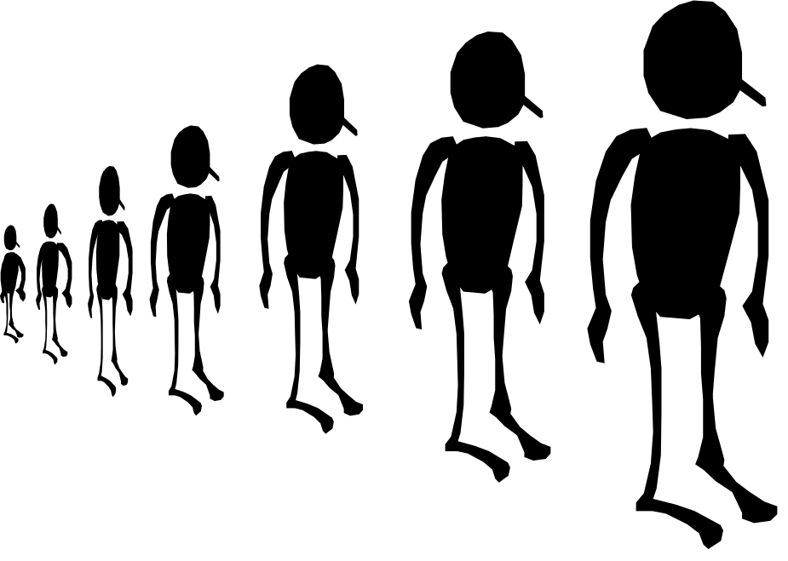

Slide 8
Trait Theories of Leadership
Ambition
and Energy
Desire
to Lead
Honesty
and Integrity
Self-
Confidence
Intelligence
Job-Relevant
Knowledge

Slide 9
Behavioral Theories
Ohio State
Initiating Structure
Consideration
Employee-Orientation
University of
Michigan
Production-Orientation

Slide 10
The Managerial Grid
9
1,9
Country Club Management
9,9
Team Management
8
7
6
Concern
for
People
5
4
5,5
Organization Man Management
3
2
1,1
Impoverished Management
9,1
Authority-Obedience
1
1
2
3
4
5
6
7
8
9
Concern for Production

Slide 11
Specific Team Leadership Roles
Coach
Liaison with
external
constituencies
Team
Leadership
Roles
Conflict
manager
Troubleshooter

Slide 12
Contingency Theories

Slide 13
Path-Goal Theory
Path-goal theory (Robert House),
  The theory that it is a leader’s job to assist followers in attaining their goals and to provide the necessary direction and support
  A leader’s motivational behavior:
    Makes employee need satisfaction contingent on effective performance.
    Provides the coaching, guidance, support, and rewards that are necessary for effective performance.
  Assumes that the leader’s style is flexible and can be changed to adapt to the situation at hand.

Slide 14
Path-Goal Leadership Behaviors
Directive leader
  Lets employees know what is expected of them, schedules work to be done, and gives specific guidance as to how to accomplish tasks.
Supportive leader
  Is friendly and shows concern for the needs of employees.
Participative leader
  Consults with employees and uses their suggestions before making a decision.
Achievement-oriented leader
  Sets challenging goals and expects employees to perform at their highest levels.

Slide 15
Path-Goal Leadership Model
Employee
Contingencies
Leader
Behaviors
Leader
Effectiveness
Directive
Supportive
Participative
Achievement-oriented
Motivated employees
Satisfied employees
Leader acceptance
Environmental
Contingencies

Slide 16
Path-Goal Model
Follower/Subordinate Characteristics
Locus of control
Experience
Ability
Leader Behavior/Styles
Directive
Supportive
Participative
Achievement-oriented
Followers/Subordinates
Perceptions
Motivation
Outcomes
Satisfaction
Performance
Environmental Factors
Tasks
Formal authority system
Work group

Slide 17
Leadership Defined
The process of influencing other to facilitate the attainment of organizationally relevant goals.
Three Important Variables
People
  Who are being lead
Task
  What people are performing
Environment
  Which the people and task exist

Slide 18
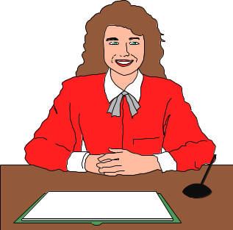
Charismatic Leadership
Defining Charismatic Leadership
  Charismatic leaders have a combination of charm and personal magnetism that contribute to a remarkable ability to get other people to endorse to their vision and promote it passionately.

Slide 19
Trait of a Charismatic Leader
Self-confidence
A vision
Strong conviction in that vision
Out of the ordinary behavior
The image of a change agent

Slide 20
Charismatic Leadership
Two Types of Charismatic Leaders
  Visionary Charismatic Leaders
    Through communication ability, the visionary charismatic leader links followers’ needs and goals to job or organizational goals.
  Crisis-Based Charismatic Leaders
    The crisis-produced charismatic leader communicates clearly what actions need to be taken and what their consequences will be.

Slide 21
Charismatic leaders. . .
. . . emphasize:
symbolic leader behavior
visionary and inspirational messages
nonverbal communication
values
intellectual stimulation
confidence

Slide 22
Transformational & Transactional Leaders
Transformational leaders
  Leading -- changing the organization to fit the environment
  Develop, communicate, enact a vision
Transactional leaders
  Managing -- linking job performance to rewards
  Ensure employees have necessary resources
  Apply contingency leadership theories

Slide 23
Transformational Leadership Elements
Building
Commitment
Creating
a Vision
Transformational
Leadership
Modeling
the Vision
Communicating
the Vision

Slide 24
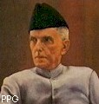
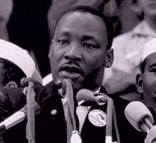
TRAITS OF TRANSFORMATIONAL LEADERS
High self-confidence
Articulates a vision
Assumes personal risk to pursue vision
Uses unconventional strategies
Perceives self as change agent
Cont.

Slide 25
TRANSFORMATIONAL LEADER TRAITS (continued)
High self-confidence
Articulates a vision
Assumes personal risk to pursue vision
Uses unconventional strategies
Perceives self as change agent

Slide 26
Transactional Leadership
old approach: reward, punish
Transformational Leadership: Leadership that inspires
Notes:
64
37

Slide 27
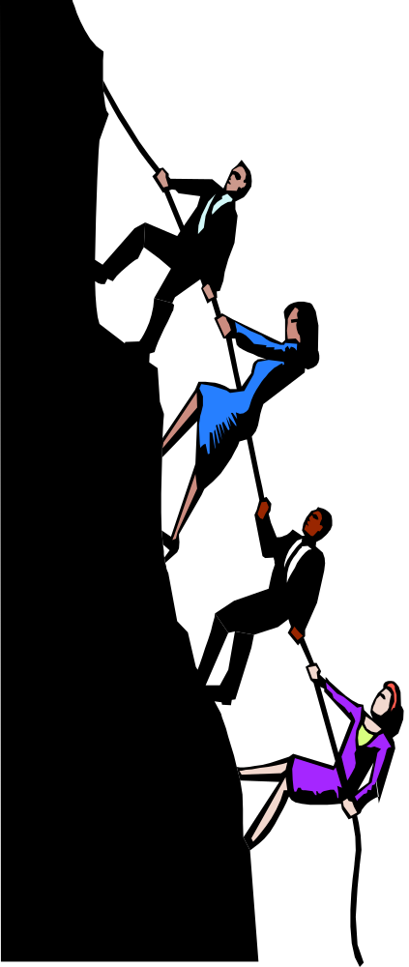

As a
transactional leader,
I use formal rewards
& punishments.
As a
transformational leader,
I inspire and excite
followers to high levels
of performance.
Notes:
8

Slide 28
Trust and Leadership
Leadership
TRUST
and
INTEGRITY

Slide 29

Trust and Credibility
Credibility: the degree to which followers perceive someone as honest, competent and able to inspire.
Trust: the belief in the integrity, character and ability of a leader.

Slide 30
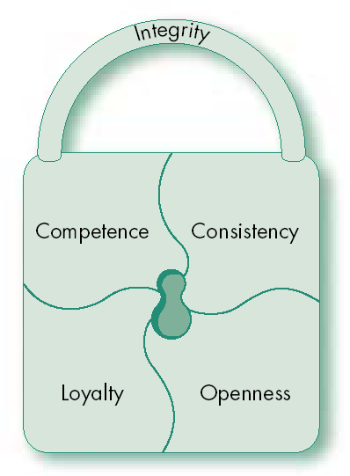
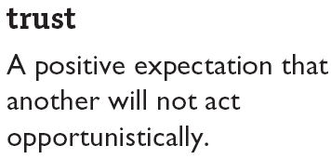
Trust: The Foundation of Leadership

Slide 31
Five Dimensions of Trust
Integrity (honesty and truthfulness)
Competence (technical/interpersonal)
Consistency (reliability, predictability and good judgment in handling situations)
Loyalty (willingness to protect and save face for a person)
Openness (willingness to share ideas and information freely)

Slide 32

Types Of Trust
Deterrence-based trust
  Trust based on fear of reprisal if the trust is violated
Knowledge-based trust
  Trust based on the behavioral predictability that comes from a history of interaction
Identification-based trust
  Trust based on an emotional
  connection between the parties

Slide 33
Building Trust
Practice
openness
Be fair
Demonstrate
competence
Speak your
feelings
Trust
Maintain
confidences
Tell the
truth
Fulfill your
promises
Show
consistency

Slide 34
Gender and Leadership
Males and females do use different leadership styles:
Women are more democratic, encourage participation, share power and information and attempt to enhance the follower’s self-worth.
Men are more directive, use command-and-control style and rely on formal authority of their position for their influence base.
Key: Gender doesn’t imply destiny. Which leadership style is effective depends on the situation. Gender simply provides a behavioral tendency in leadership style.

Slide 35
Assessing Your Leadership Skills

Slide 36
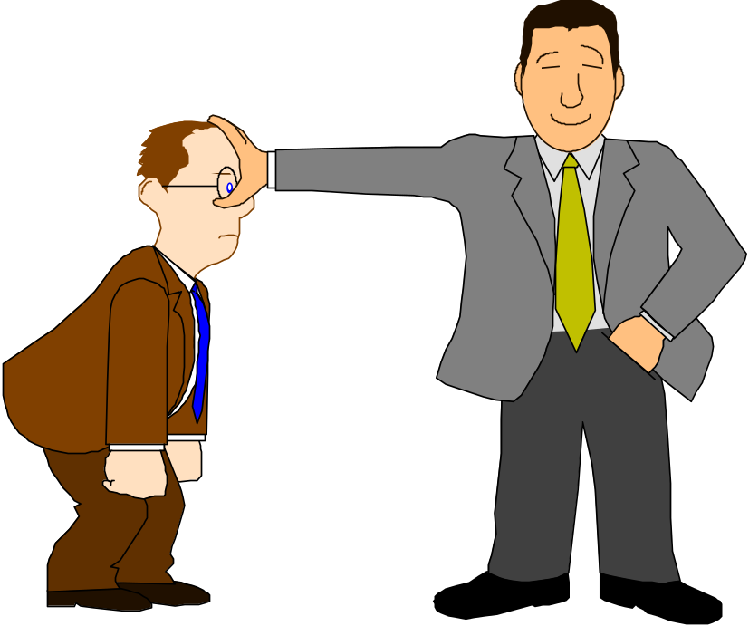
Can You Establish Trust & Rapport With Others?

Slide 37
5 Ways To Build Trust & Rapport
Find Some Common Ground
Avoid Getting Angry
Watch Your Body Language
Monitor Your Voice Tone
Agree With & Show Concern For Problems

Slide 38
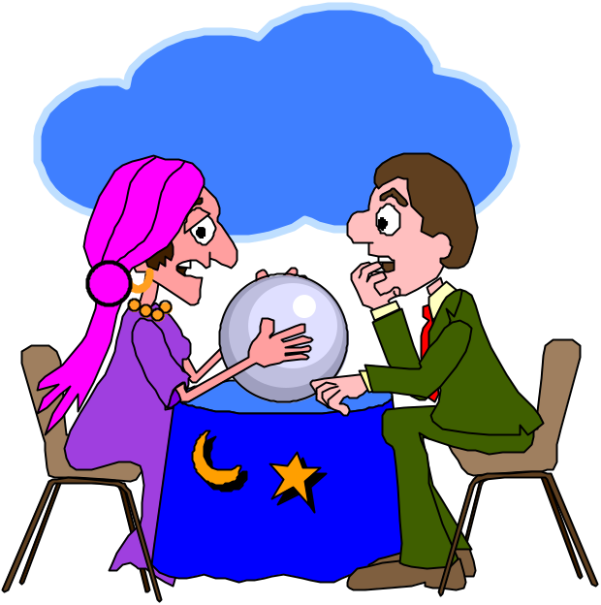
Can You Help Create and Communicate A Vision?

Slide 39
Can You Communicate Effectively?

Slide 40
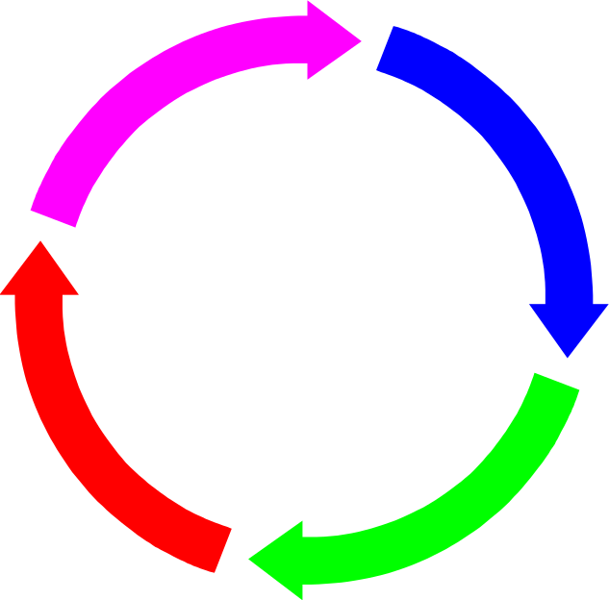
4 Ways To Improve Communications
Develop Trust & Rapport
Understand Different Communication Styles
Create a Favorable Communication Climate
Become a Better Listener

Slide 41
Can You Bring Yourself To Taking Acceptable Risks?
Notes:
Games
“Past The Risks Please”
“The Times Of Change Change”
“Risk Doctor”

Slide 42
Acceptable Risktaking
Potential gains are far greater than potential losses.
There is a reasonable chance the risk will pay off.
Risktaking is rewarded by the organization even when it doesn’t pay off.
Not taking the risk has negative consequences.
You and the company can quickly recover from the potential losses.

Slide 43

Can You Delegate To Others?

Slide 44
Some Rules Of Delegation
Assign The Whole Task
Describe Success In Terms Of Outcomes
Delegate Authority Along With Responsibility
Tell How Project Fits Into The Big Picture
Explain Relative Priority Of The Project
Give An Incremental Timetable
Make It Rewarding For The Employee
Provide Periodic Feedback
Notes:
Complete “Delegation Worksheet”

Slide 45

Can You Keep Your Leadership Style Flexible?
MOTIVATIONAL
STYLE
COUNSELOR
STYLE
RESOURCE
STYLE
INSTRUCTOR
STYLE

Slide 46
A Leaders’ Vision Of the Future Can Align Efforts and Help Groups Accomplish More
Groups that lack vision
Groups with vision

Slide 47
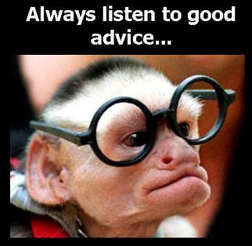

Slide 48
“Leadership is the art of accomplishing
more than the science of management
says is possible.”

Slide 49
"Great leaders are almost always great simplifiers,
who can cut through argument, debate and doubt,
to offer a solution everybody can understand."

Slide 50
"Organization doesn't really accomplish anything. Plans
don't accomplish anything, either. Theories of management
don't much matter. Endeavors succeed or fail because of
the people involved. Only by attracting the best people will
you accomplish great deeds."

Slide 51
"Never neglect details. When everyone's mind is dulled
or distracted the leaders must be doubly vigilant."

Slide 52
"The day people stop bringing you their problems is the
day you have stopped leading them. They have either lost
confidence that you can help them or concluded that you
do not care. Either case is a failure of leadership."

Slide 54
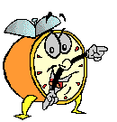
Let’s stop it here

Slide 55
Summary

Slide 56
Next….

Slide 57
Organizational Behavior
(MGT-502)
Lecture-23

